Slide 1

Exploring Agri-Market Insights Price Trends and Market Intelligence
By – Vishal Chavanke...

Slide 2
About me:-
Name:- Vishal Khanderao Chavanke.
Education:- B.sc Computer Science.
Linkedin:- www.linkedin.com/in/vishal-chavanke-b96839268
Github:- https://github.com/vishal0425

Slide 3
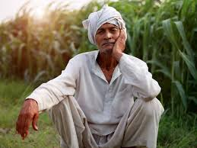

BUSINESS PROBLEM::
Farmers work hard to grow their crops but face Difficulties when selling crops, they do not know which market offers better prices.
Without this clear information, they often sell to local vendors at lower rates and later regret missing higher prices in other markets.
Farmers don’t know which market will give them the best price.
OBJECTIVE OF THE PROJECT::
To analyze market-wise and district-wise prices for different Varities.
  To provide clarity on best markets for farmers to sell their vegitables.
  To track highest and lowest arrivals & prices for better decision-making
  To study the relationship between supply and price
  To create visual insights that farmers, vendors, and businesses can easily understand

Slide 4
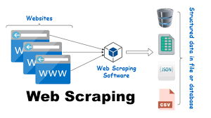
Web Scraping
Web scraping is the process of automatically extracting data from websites. It helps collect large amounts of real-time information for analysis.
How Web Scraping Works:
Send Request: A request is sent to the website to access its data.
Fetch Web Page: The website responds with an HTML page containing the required data.
Extracting Data: Using tools like BeautifulSoup pecific information is extracted.
Clean & Organize Data: Raw data is processed, structured, and converted into tables or datasets.
Store Data: The cleaned data is stored in formats like CSV, Excel, or Database for future use.
Analyze & Visualize:Finally, the data is analyzed with tools like Pandas, Matplotlib, or Power BI, helping farmers, vendors, and businesses gain real insights.

Slide 5
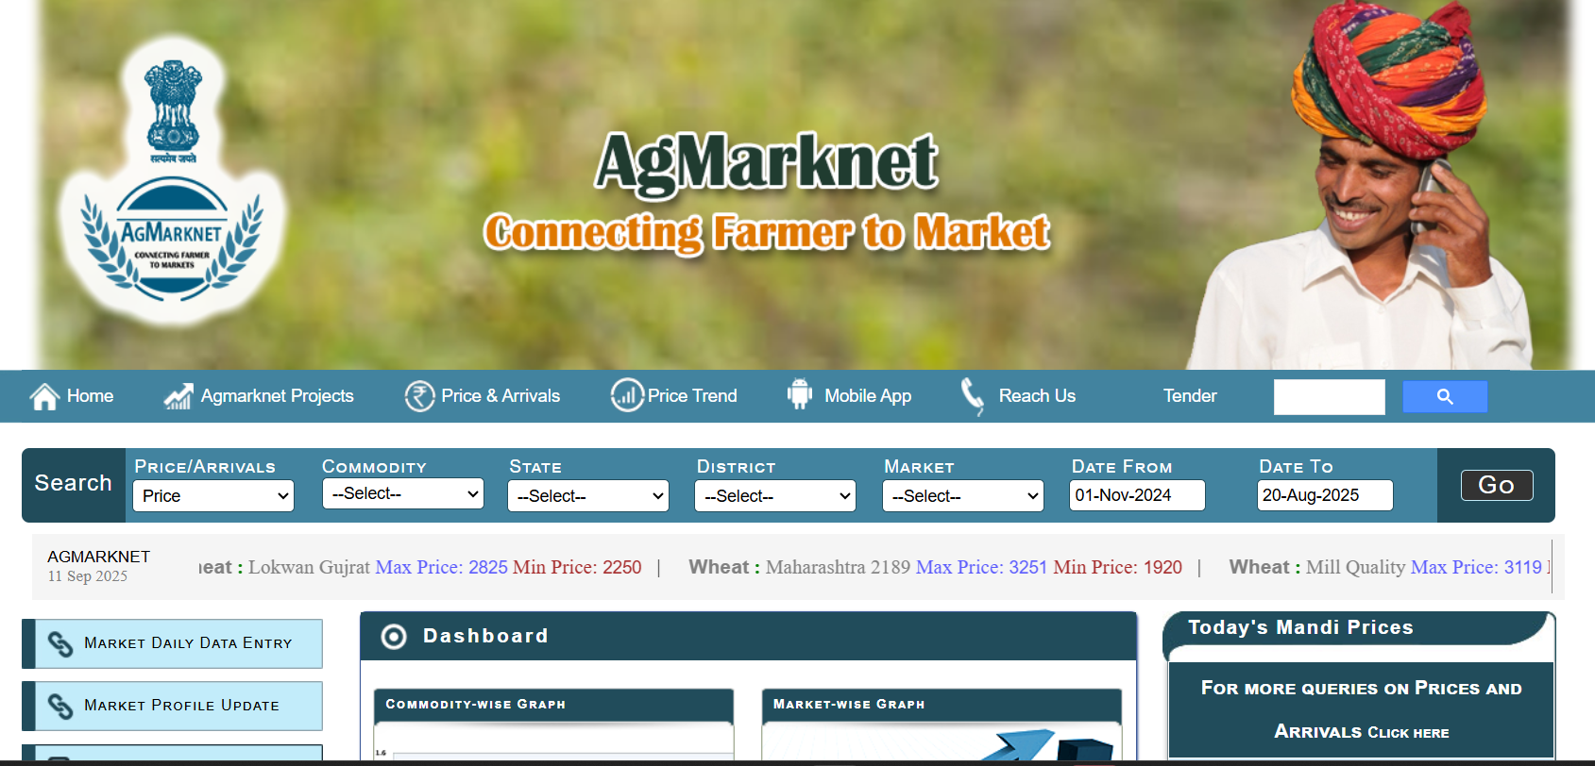
Interface Of Website:

Slide 6
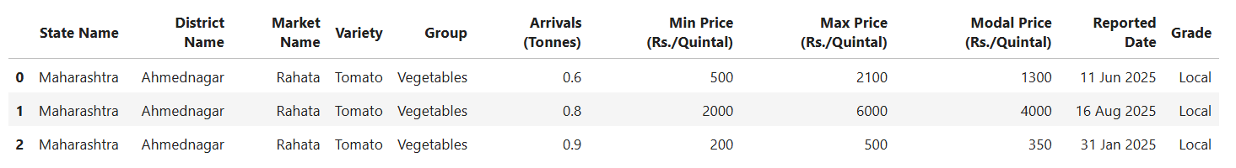
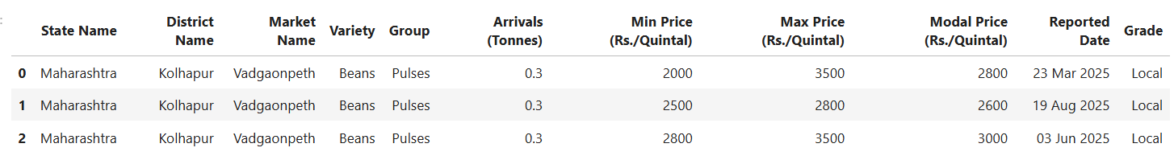
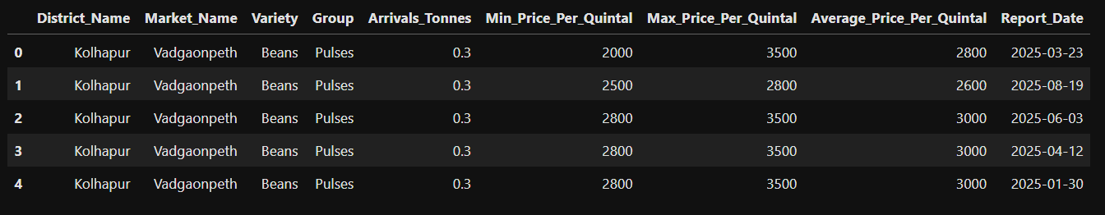
Old Data
New Data

Slide 7
Visualization:
Data Visualization is the process of transforming raw data into visual formats(charts, graphs, maps) to make trends, patterns, and relationships easier to understand and communicate effectively.
It helps in faster decision-making, storytelling with data, and identifying hidden insights.
There are 3 main types of Data Visualization techniques:
1. Univariate Analysis: The analysis of one variable at a time. Example: Average price of Tomato in different districts.
2. Bivariate Analysis: The analysis of the relationship between two variables. Example: Relationship between arrivals (supply) and average price,
3. Multivariate Analysis: The analysis of three or more variables simultaneously. Example: Impact of variety market, and arrivals on price trends.

Slide 8
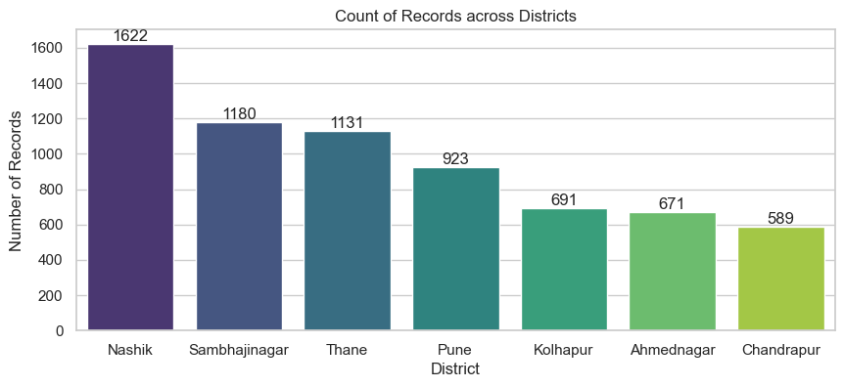
Univariate Analysis
Nashik District has the highest number of records (1622), showing Nashik is a Major trading hub.
Districts like Sambhajinagar, Thane & Pune also have strong activity.
Ahmednagar and Kolhapur – Both show almost the same level of data
In Chandrapur District Vegetable production is decreasing here, which is why its records are low.

Slide 9
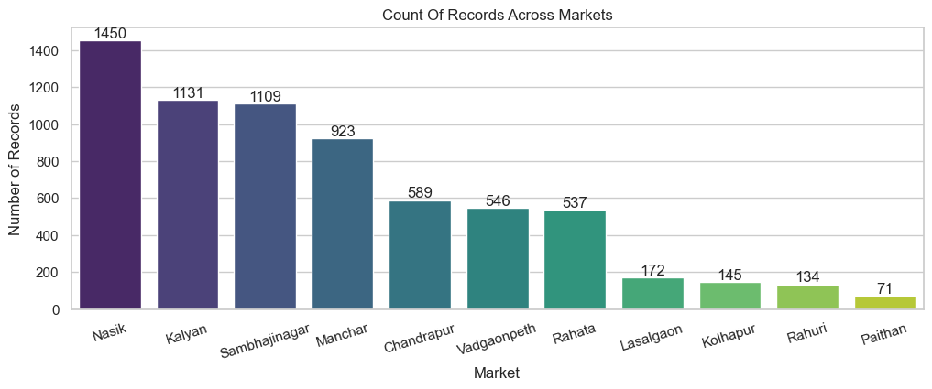
Market wise highest and lowest Records
Nashik Market is the most active market with maximum records in Maharashtra.
Kalyan, Sambhajinagar and Manchar also have high participation.
Smaller markets like Paithan and Rahuri show low activity.

Slide 10
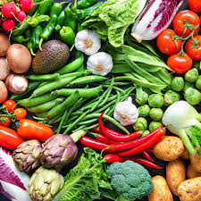
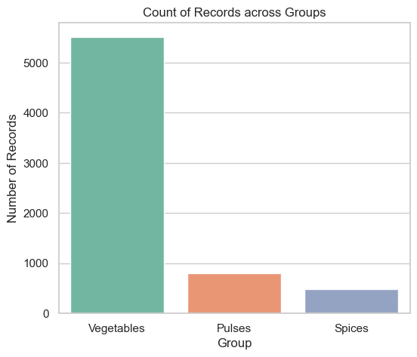
All varieties are divided into three main categories
Vegetables – the largest group, including cabbage, brinjal, tomato, potato, carrot, capsicum, and onion.
Pulses & Spices– represented by Beans & Garlic

Slide 11
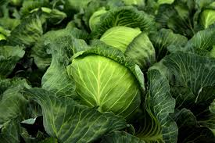
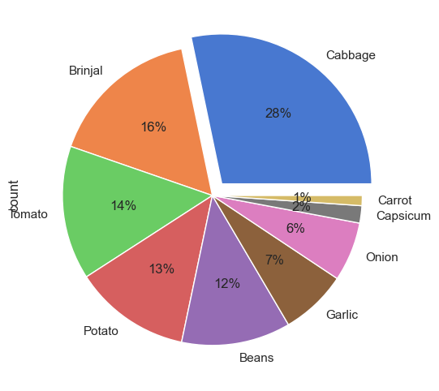
Variety-wise Highest Market Records
Cabbage has the largest share (28%).
Brinjal, Tomato, Potato, and Beans have a good part (12%–16%).
Carrot and Capsicum have a very small part.
Cabbage, Brinjal, and Tomato are the main crops with the largest share, safer for steady income
Garlic & Onion have a smaller part but can give higher profit.

Slide 12
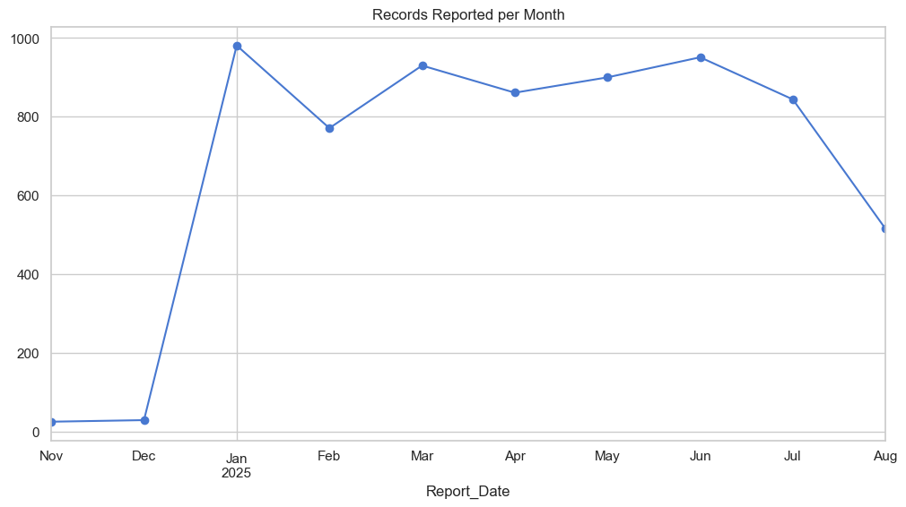
In Nov and Dec , very few records were reported (close to 30–40 only).
Records peaked in January 2025, showing the highest market activity.
Consistently strong reporting was observed from January to July.
August shows a decline, indicating reduced arrivals or incomplete reporting.

Slide 13
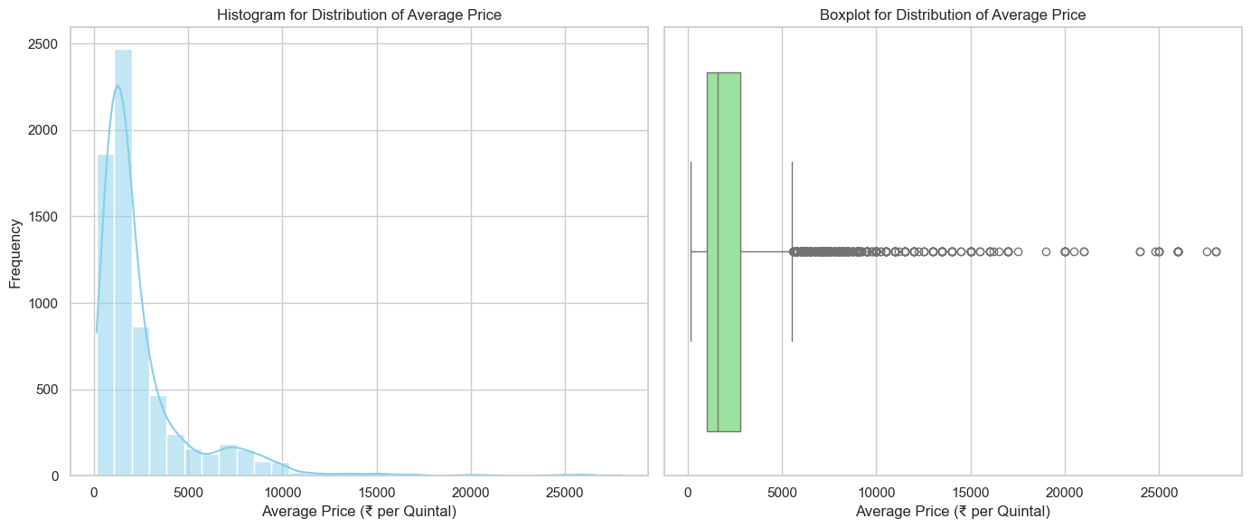
Statistical Distribution of Average Prices
Most crops price are between the 500–3000 per quintal (common price range).
Only, Few crops reach very high prices, more than 5000, but these are rare cases. As we can say these are the outliers.
Prices are uneven and unstable, with many sudden highs and lows (outliers).

Slide 14
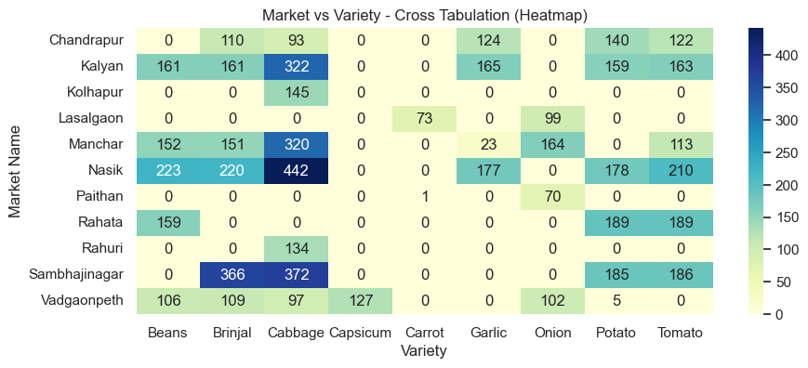
Bivarite analysis
Market Strength Analysis Across Crop Varieties
Nasik, Kalyan, Manchar, Sambhajinagar are major hubs with Maximum crop presence.
Kolhapur, Rahuri, Lasalgaon, Paithan are specialized markets.
Cabbage, Beans, Tomato, Onion are the most prominent varieties across markets.
Garlic, carrort & Capsiappears in only a few markets (not widely distributed).

Slide 15
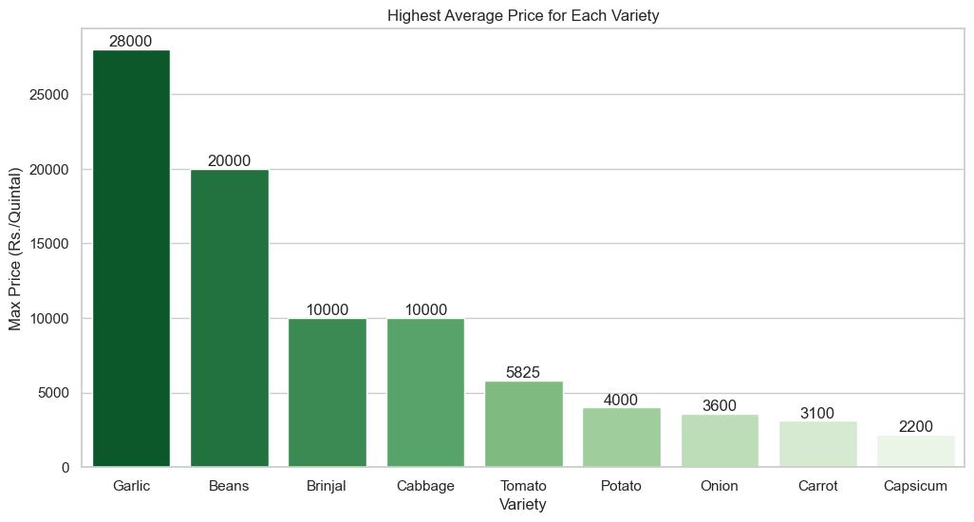
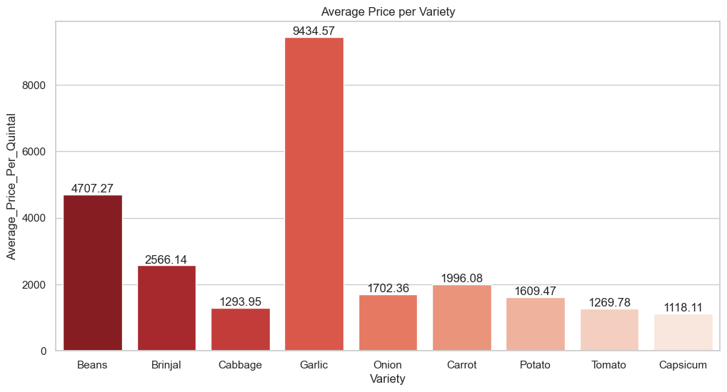
Highest & Average Price For Each Variety
Garlic is the most expensive variety by a significant margin.
High-priced: Garlic and Beans (Rs. 28,000 and Rs. 20,000).
Mid-priced: Brinjal, Cabbage, and Tomato (Rs. 10,000 to Rs. 5,825).
Low-priced: Potato, Onion, Carrot, and Capsicum (Rs. 4,000 to Rs. 2,200).
Again Garlic has the highest average price, far above all other crops.
Beans also fetch good prices, while Brinjal and Carrot are mid-range.
Onion, Potato, Cabbage, Tomato, and Capsicum are the lowest-priced varieties.

Slide 16
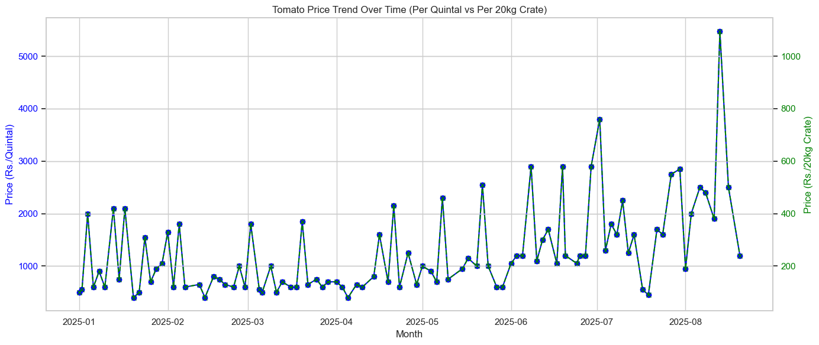
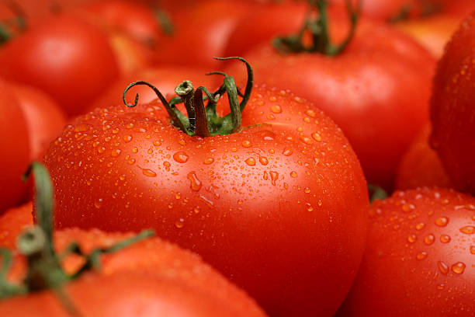
Currently Tomato is Trending for the farmers, in our da
By converting into 20kg crate prices (practical unit used by farmers), we clearly see the day-to-day earning potential per crate.
Prices generally stayed between ₹200–₹600 per crate, with occasional spikes above ₹1000 (profitable windows).
These spikes usually align with seasonal demand and supply shortages, meaning farmers who monitor trends can time their sales better.

Slide 17
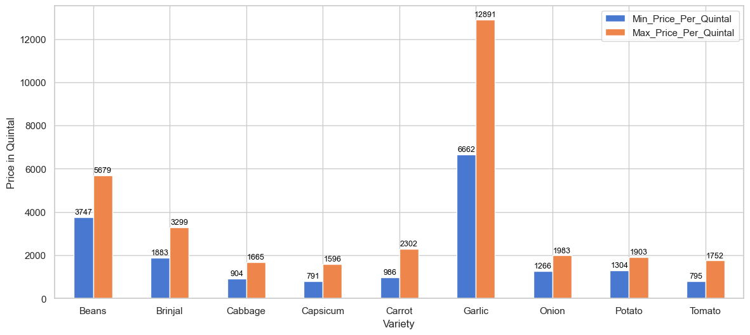
Look, even though the price of garlic is high, farmers do not plant more garlic because the same is produced in less quantity, so people plant more other vegetables. which keeps the supply low and prices high
On the other hand, crops like cabbage, carrot, and capsicum have lower prices, but they are grown in large quantities, so farmers still prefer them for steady income.

Slide 18
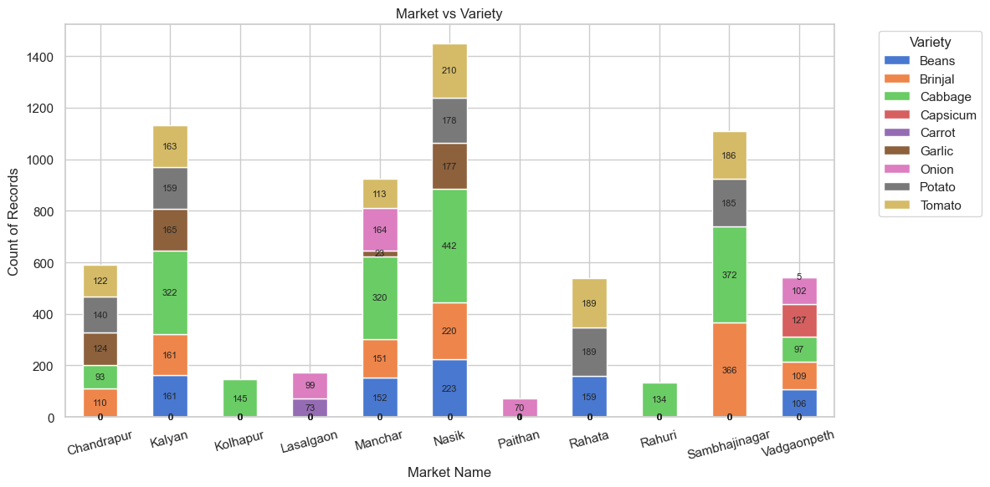
Multivariate Analysis
Nasik is the central hub for almost every crop, making it the most diversified and dominant market.
Kalyan, Sambhajinagar, Manchar are also major markets with multi-crop dominance.
Kolhapur, Rahuri, Lasalgaon are specialized markets focusing on 1–2 crops only.
Cabbage, Beans, Tomato, Onion are the top four crops across Maharashtra markets.

Slide 19
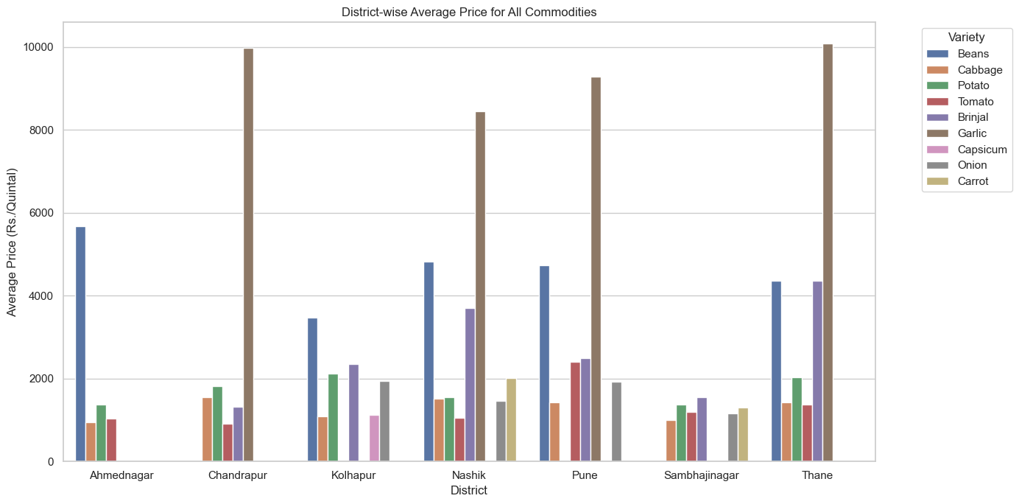
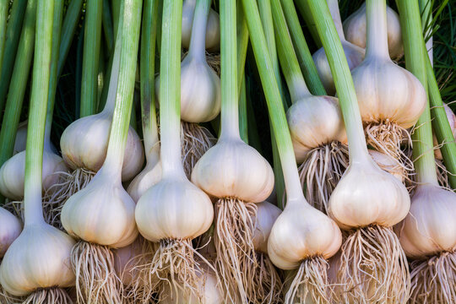
A farmer growing garlic can earn the highest prices, especially if he sells in Thane or Chandrapur.
If he grows beans, Nashik and Pune markets are the best options to get good returns.
For crops like potato, cabbage, tomato & onion, prices are lower but stable, so farmers can sell safely without much risk.
Choosing big markets like Nashik, Pune, and Thane can help farmers get better profits compared to small markets.

Slide 20
Conclusion:
Web scraping gives real-time market insights on prices and arrivals.
Farmers can compare markets to find the best selling opportunities.
Helps in crop planning by showing which varieties are in demand.
Reduces dependence on middlemen and local traders.
Ensures better income, reduced losses, and smarter decisions.

Slide 21
THANK YOU !

